Slide 1

Customer Segmentation using Data Science
Submitted by:
F . ANTONY RAJAN (961721104303)
A . FRENI (961721104008)
A . EBISTON (961721104307)
P . FRANKLIN GINO (961721104308)
M.S. JEBINLAL (961721104309)

Slide 2




Agenda
Introduction
Data Collection and Preprocessing
Customer Segmentation Methodology
Exploratory Data Analysis
Results and Insights
Conclusion

Slide 3


Introduction
Customer segmentation involves implementing data science methods to divide the customer base into smaller groups based on certain characteristics.
It assists marketing managers in better understanding their customers' preferences and presenting them with better-targeted advertisements.

Slide 4
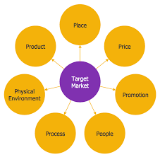
Data Collection and Preprocessing:
Data sources
Data collection methods
Data cleaning and preprocessing steps
Mention any challenges encountered

Slide 5


Customer Segmentation Methodology
Customer segmentation is a crucial strategy for businesses to better understand and target their diverse customer base.
By dividing customers into distinct groups based on shared characteristics, behaviors, and preferences, companies can tailor their marketing efforts, product offerings, and customer service to meet the specific needs of each segment.

Slide 6
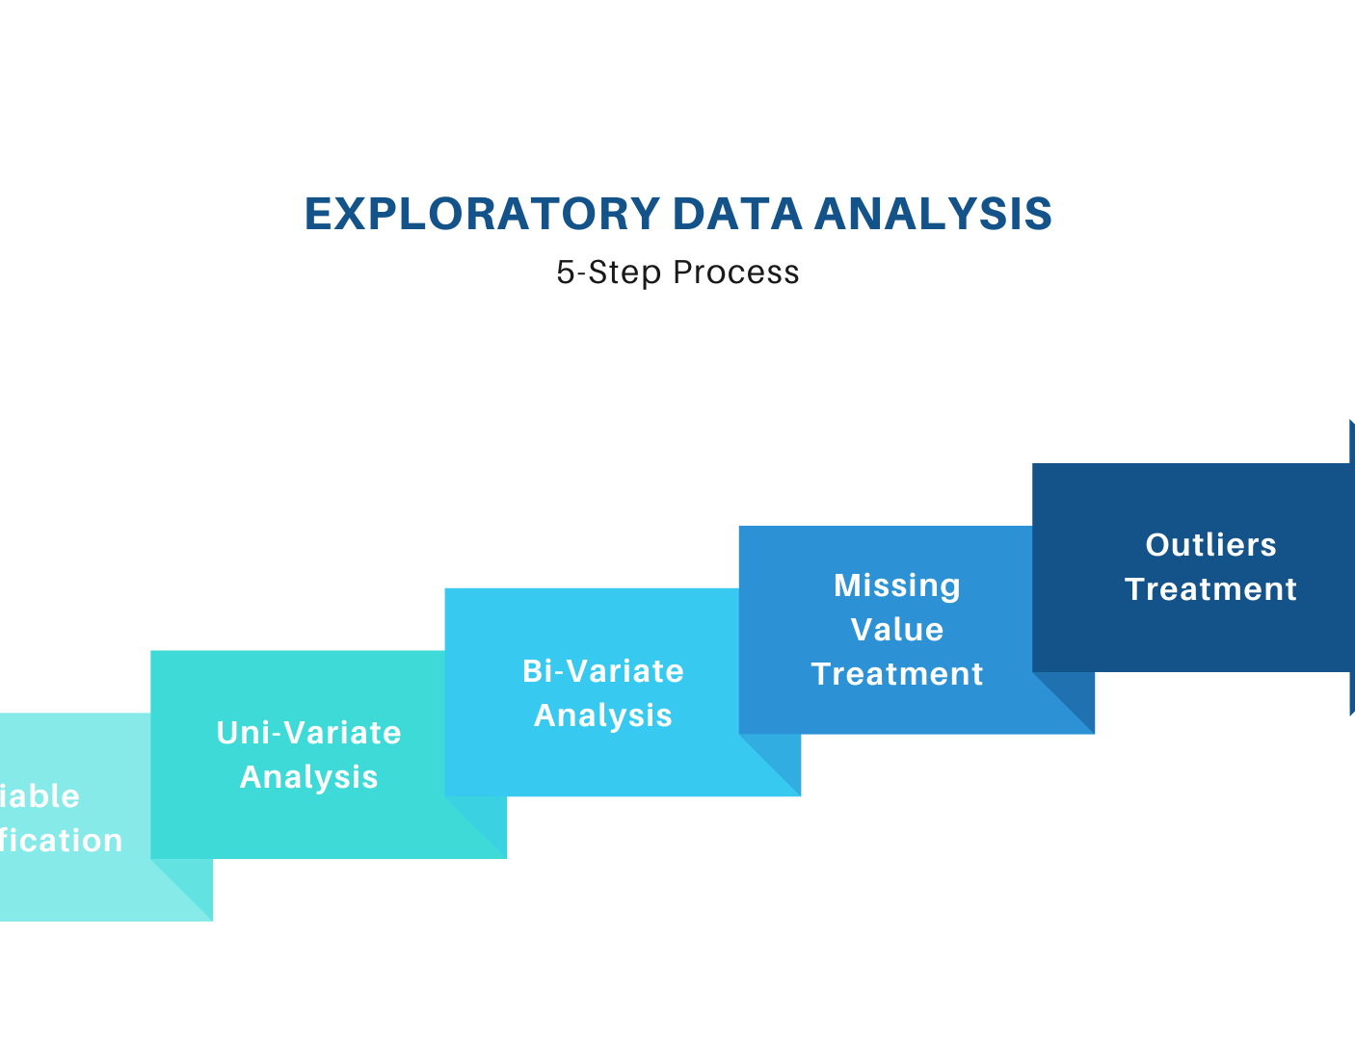
Exploratory Data Analysis
Summary statistics
Data visualizations (histograms, scatter plots, etc.)
Key insights from EDA

Slide 7

Results and Insights
Here are some common results and insights that can be gained from customer segmentation:
Targeted Marketing Efforts
Product Customization
Optimized Pricing Strategies
Improved Customer Experience
Customer Retention
Market Expansion Opportunities
Cost Reduction

Slide 8


Conclusion:
customer segmentation is a powerful strategy that enables businesses to gain a deeper understanding of their diverse customer base and tailor their marketing, product development, and customer service efforts to meet the specific needs of different customer groups

Slide 9

Thank You

